Slide 1
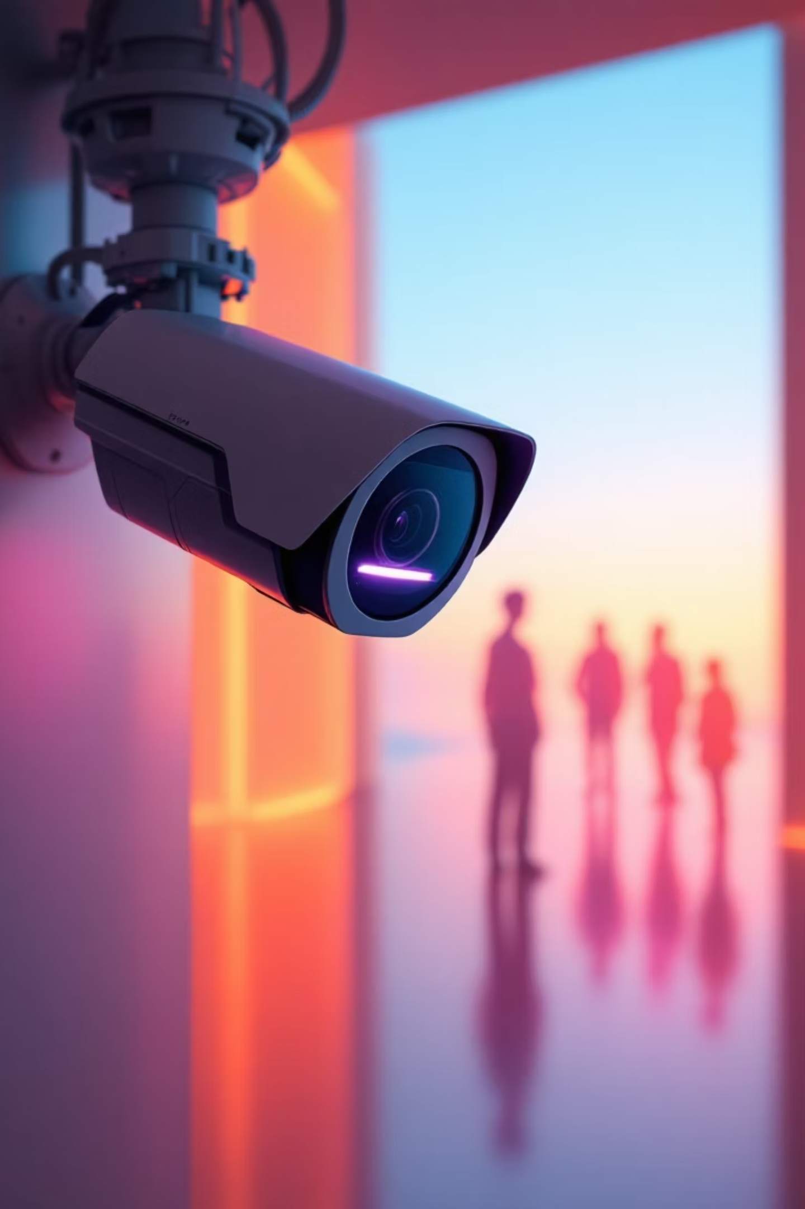

ARRIVAL AND DEPARTURE TRACKING USING COMPUTER VISION
( InOutVision)
Group Members:
Karamoko Ibrahim Kané Soumare - 300203291
Stanley vianney Foumi Nkwengwa – 300453806
Elam Olame Mugabo - 300239792
Course: ELG5255 - Applied Machine Learning
Semester: Fall 2025

Slide 2

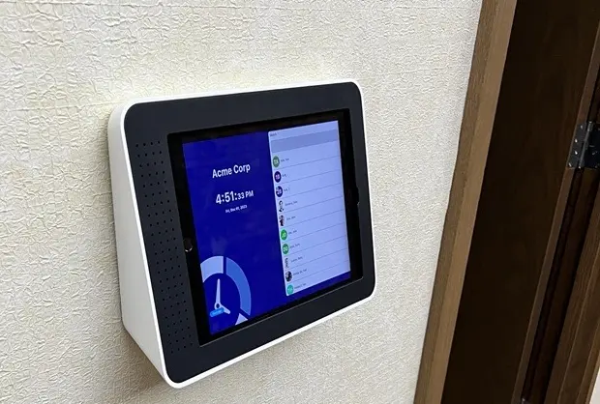
Motivation & Concept
Badge Systems
Manual Attendance
Easy to lose, share, or forget. No verification of actual person presence.
Time-consuming, error-prone, and easily manipulated by proxy attendance.
Basic CCTV
Requires constant human monitoring. No automated threat detection or alerts.

Slide 3
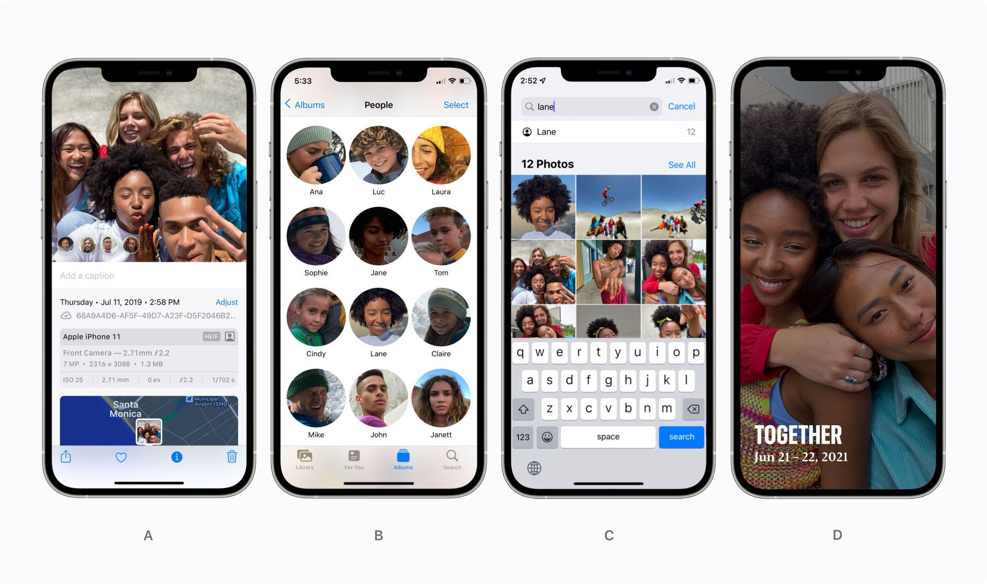

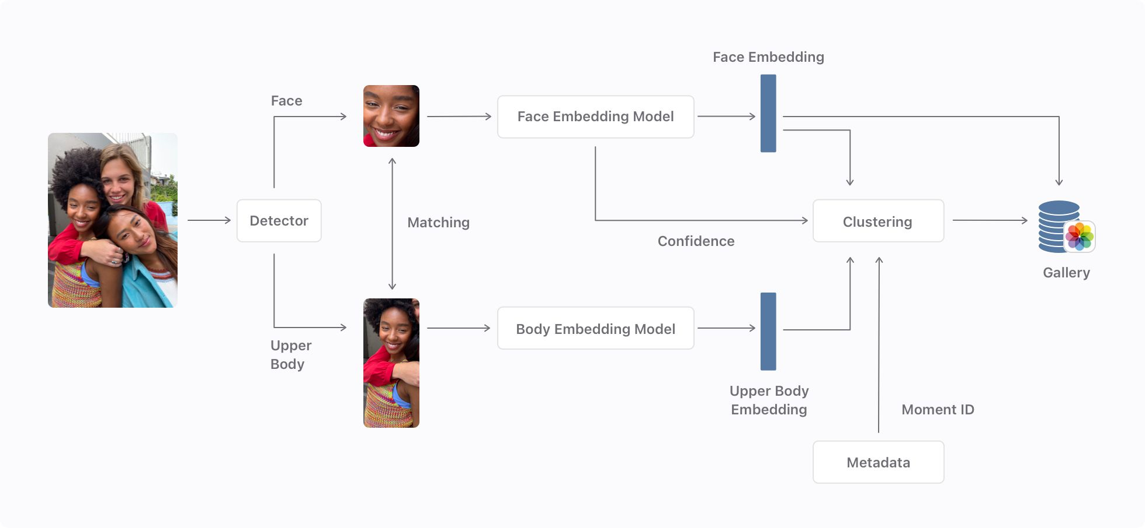

State-of-the-Art Computer Vision Technologies
Relevant Applications
Recognizing People in photos through private-on-device Machine Learning. - Apple Machine learning Research Paper:
https://machinelearning.apple.com/research/recognizing-people-photos
Facial Recognition
ArcFace achieve state-of-the-art performance with 99.6% accuracy on LFW benchmark datasets.

Slide 4
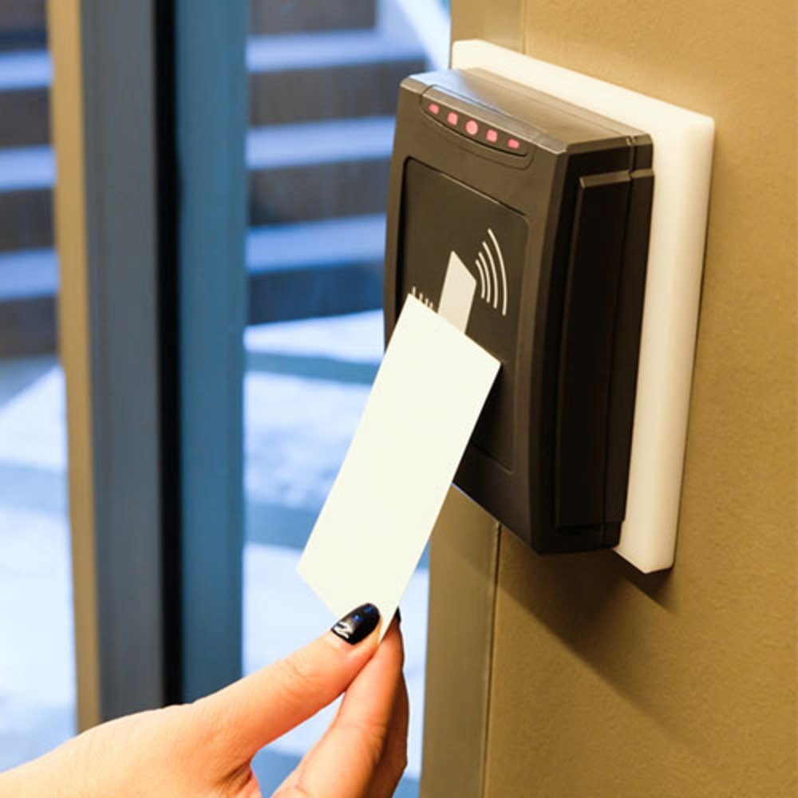

Problem definition
" Every year, Canadians throw away over 3 million tons of plastic."
Our Goals
Replace the traditional badge clock in system by developing a facial recognition-based attendance system capable of logging entry and exit times for employees with at least 90% recognition accuracy, eliminating the need for physical ID badges.
Our Goals
Replace the traditional badge clock in system by developing a facial recognition-based attendance system capable of logging entry and exit times for employees with at least 90% recognition accuracy, eliminating the need for physical ID badges.
Organizations use plastic or RFID ID badges for attendance tracking, but frequent replacements cause significant plastic waste and environmental harm.

Slide 5
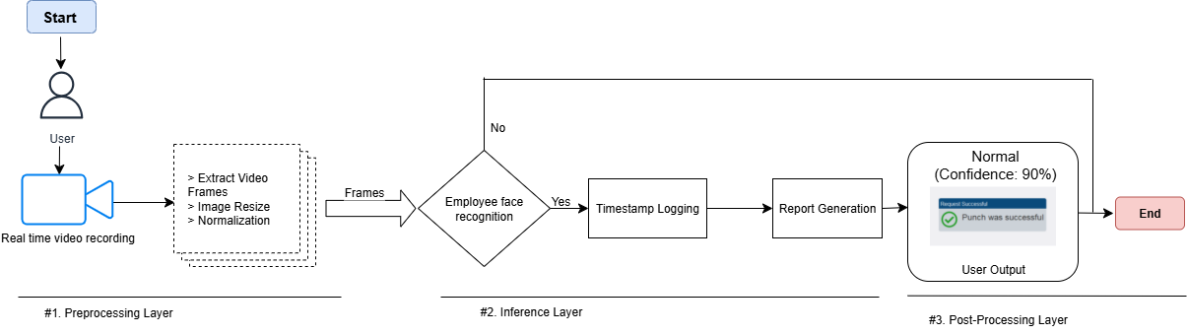
Our Proposed Solution
Pipeline workflow
Model selection
YOLOv8 enables real-time and accurate object detection
FaceNet enables highly accurate facial recognition

Slide 6
Project Feasibility & Timeline
Weeks 1-3
Weeks 7-8
Dataset preparation, model selection, and initial training setup.
System deployment, performance evaluation, and demonstration preparation.
1
2
3
Weeks 4-6
Model training, optimization, and integration testing.
90%
30fps
Target Accuracy
Processing Speed
Face recognition performance goal
Real-time video analysis capability

Slide 7
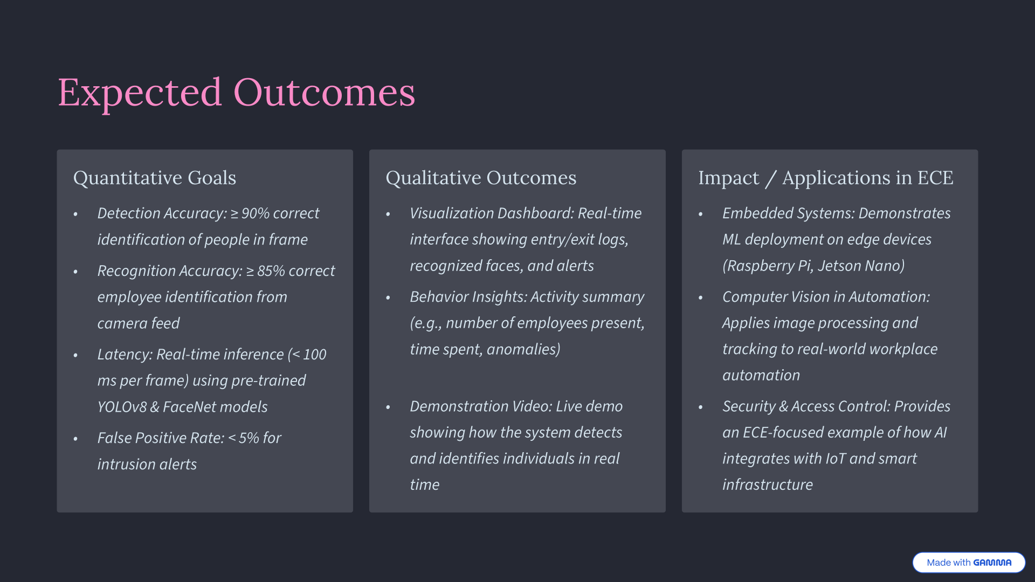

Slide 8






Visual Summary
Advancing Beyond Existing Work
Combines attendance automation + intrusion detection in one unified model
Uses real-time computer vision instead of manual logs or badge scanners
Emphasizes practical deployment and low-latency inference for real environments
Detection
Tracking
Camera Input
Recognition
Our system extends traditional CCTV by adding real-time intelligence — recognizing individuals, logging attendance, and flagging anomalies automatically.

Slide 9

Conclusion
Applied computer vision and ML to automate attendance and enhance security
Used pre-trained models (YOLOv8, FaceNet) to achieve real-time detection and recognition
Designed a practical, deployable system relevant to ECE applications (IoT + AI)
Feasible within semester scope with potential for real-world adoption

